Slide 1
Quantum Computing: A Full Stack Problem
Swamit Tannu

Slide 2
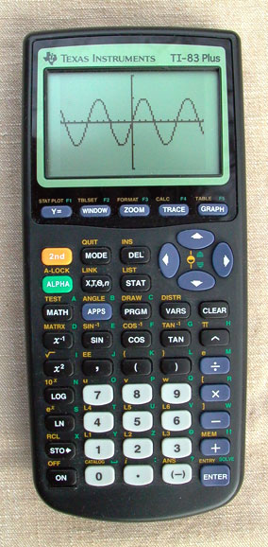
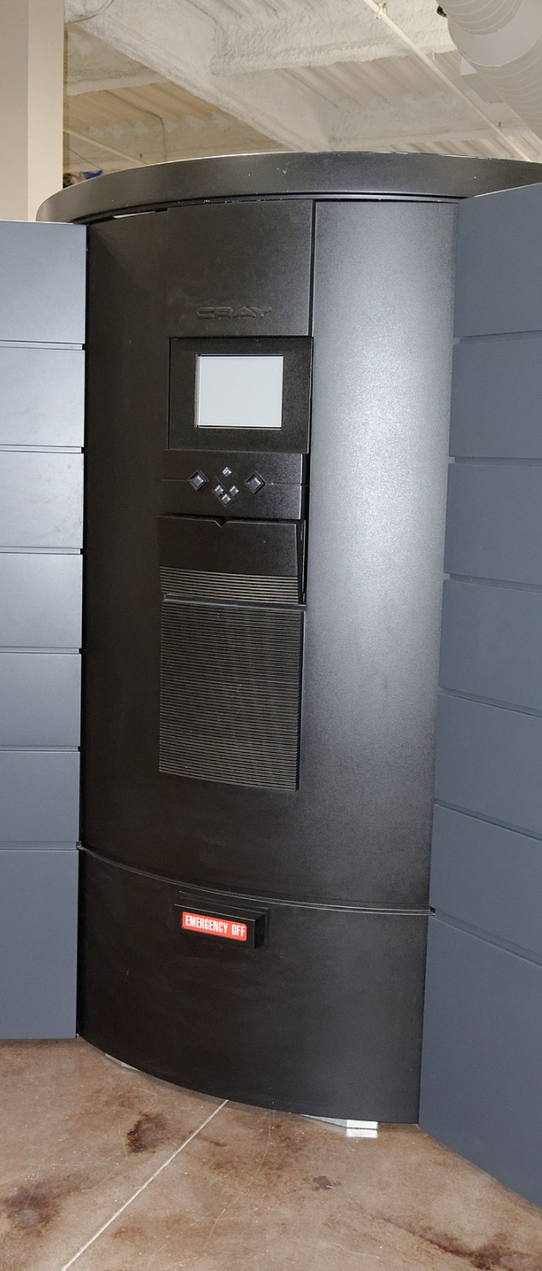
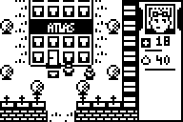
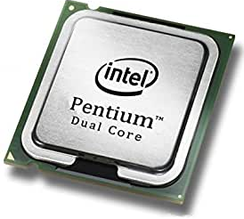
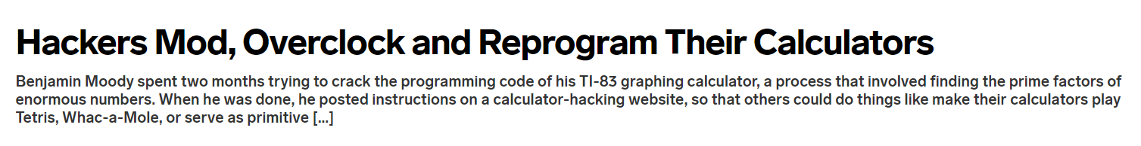
In 1999
Breaking 512-bit RSA would have required six months on a Cray Supercomputer
TI-83 Plus
Launched: 1999
Hacked In: 2009
In 2009
Breaking 512-bit RSA required
73 days on PC

Slide 3
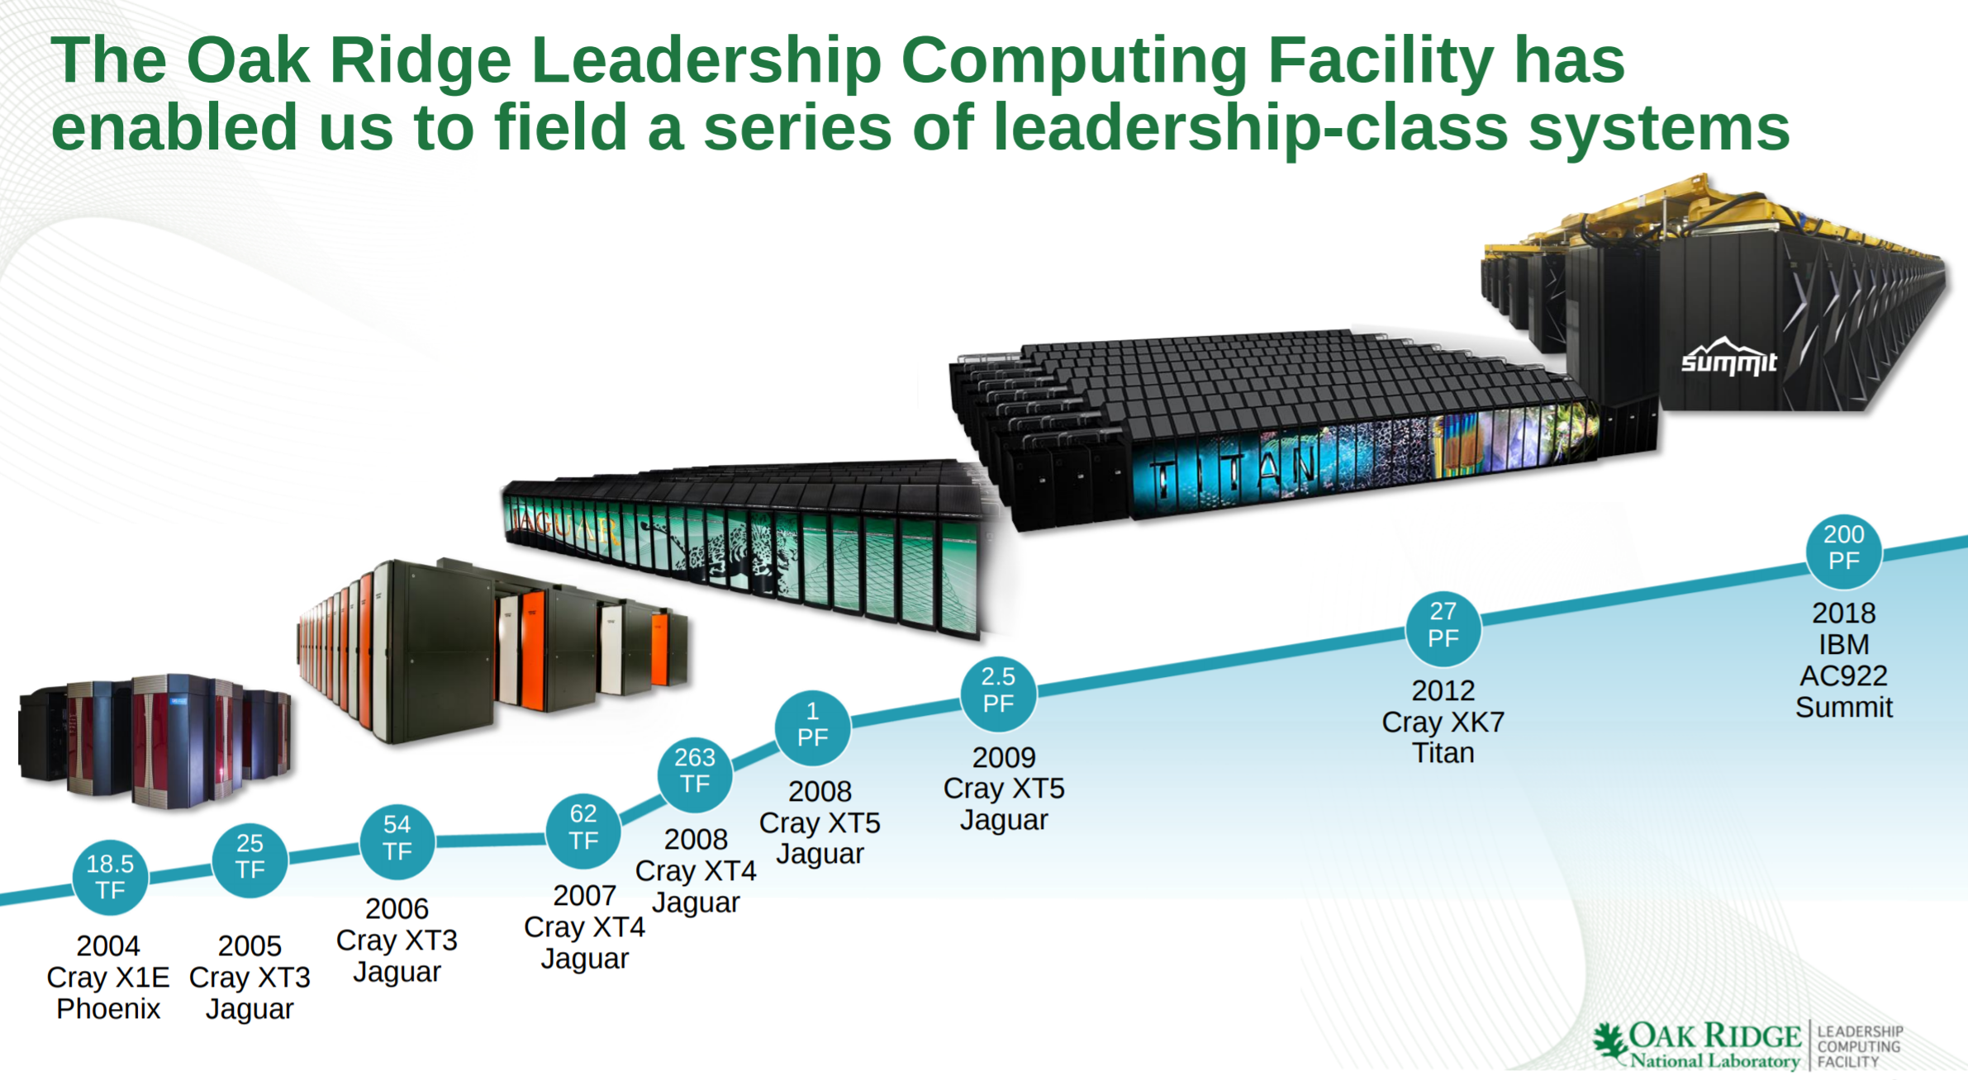
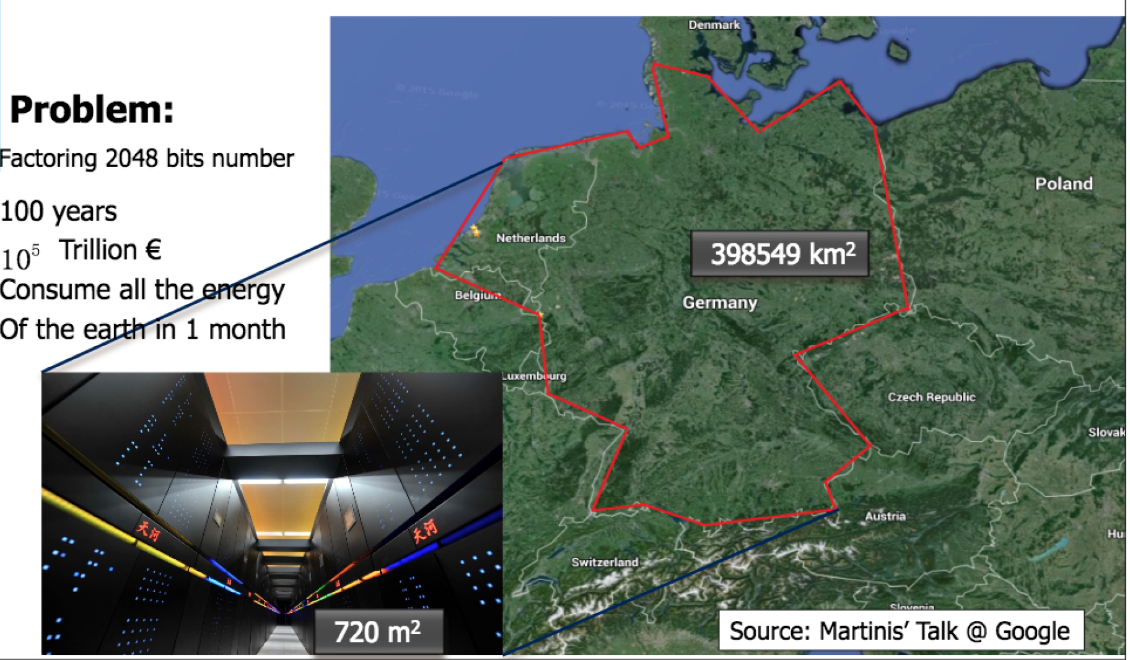
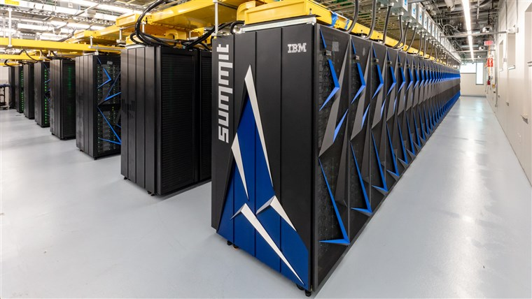
Why Quantum Computers?
Tera FLOPs (TF) → 10¹²
Peta FLOPs (PF) → 10¹⁵
Time to factor 2048-bit number?
Quantum Computer Factor 2048 bit Number in 8 hours
Supercomputer that uses all energy of earth will take 100+ years
Source: Gidney and Ekerå [2019]
Source: Oak Ridge National Lab

Slide 4
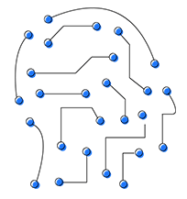
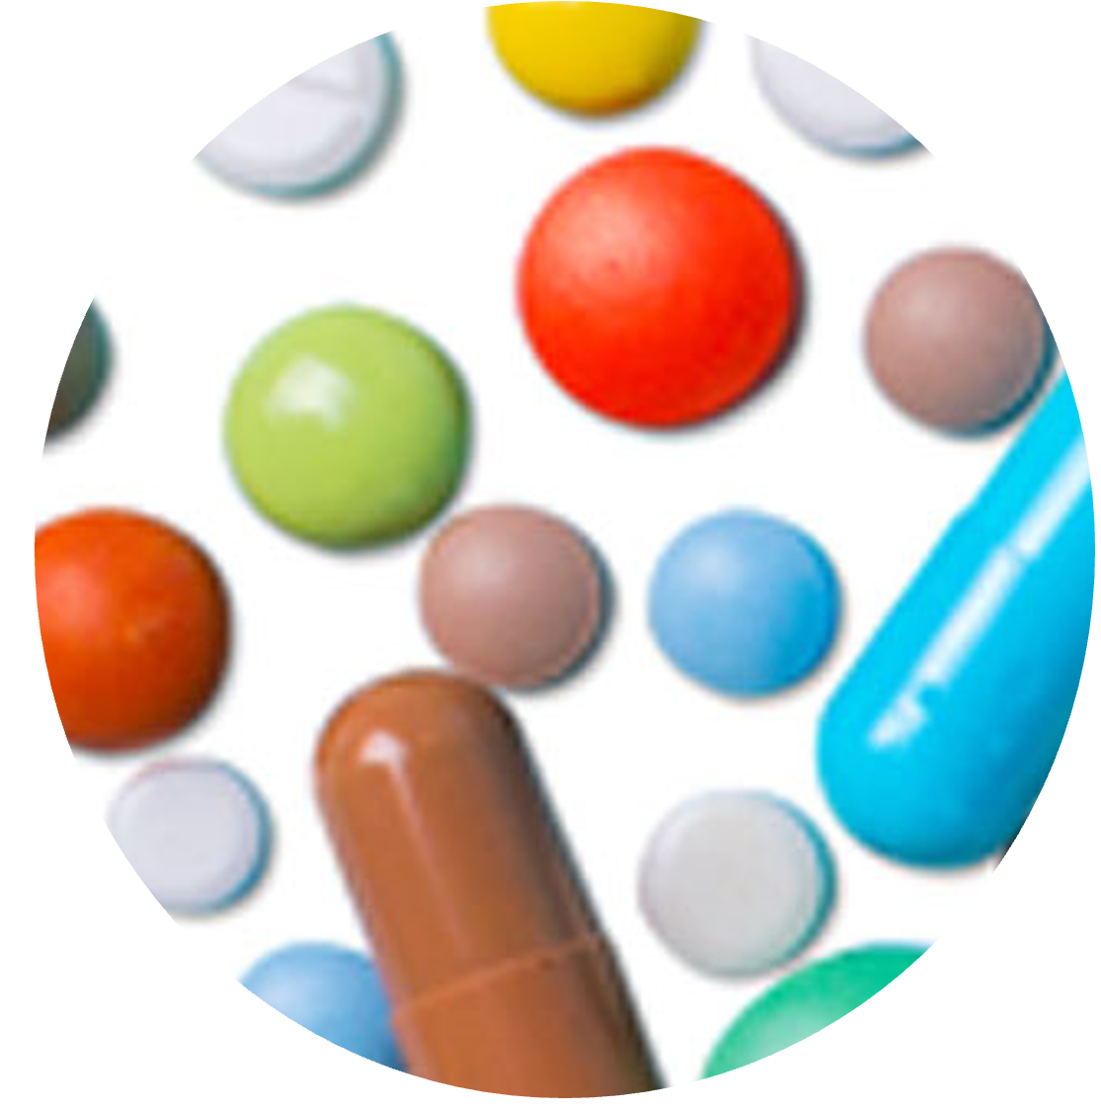


Potential of Quantum Computers
Machine Learning
Drug Discovery
Logistics
Energy
Classical Computer
Execution Time
Optimization
Problems
Quantum Simulations
Quantum
Computer
Algebraic Problems
Problem Size
Quantum Computers can enable solutions to important problems

Slide 5
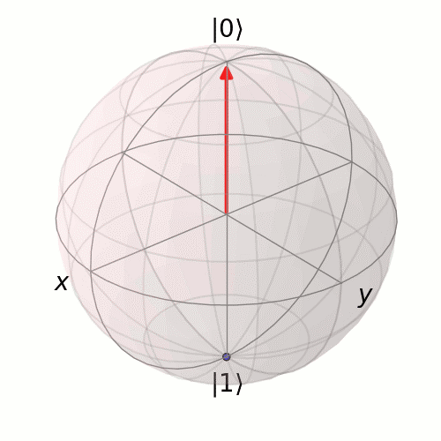
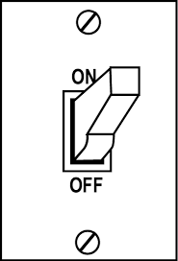
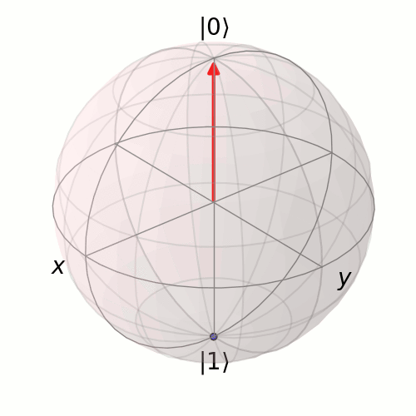
Computing using Quantum Bits
1
1
0
0
Classical Bit
Quantum Bit
State of a Quantum Bit
Any point on the sphere
(Vector in Complex Hilbert Space)
State of a Classical Bit
→ 1 or 0 two points on sphere

Slide 6
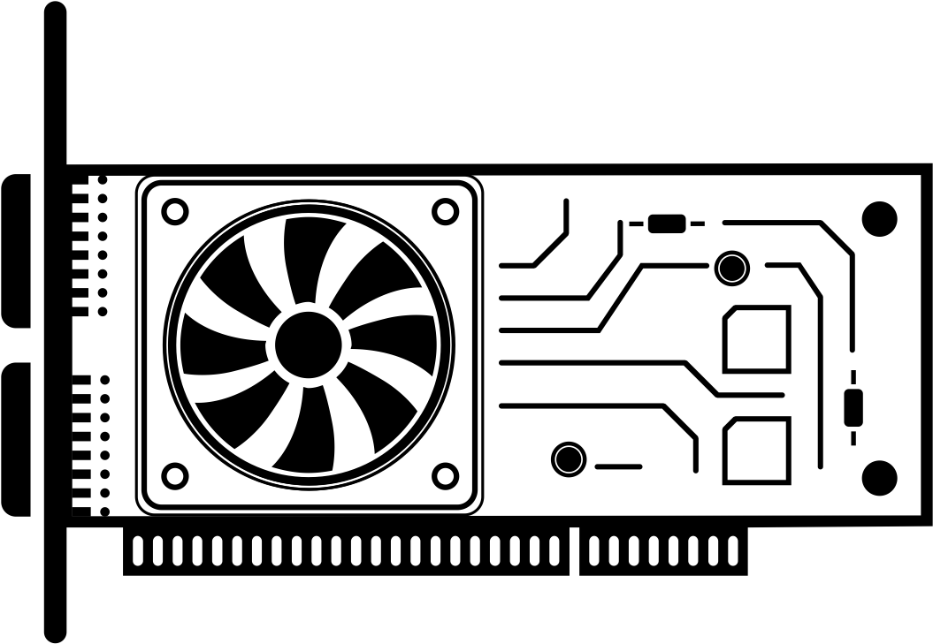



Quantum Computer is an Accelerator
Architects can help
Quantum Processing Unit
(QPU)
N → $\frac{\text{N}}{m}$
Control Electronics
GPU
N → C.$\sqrt{N}$
Reduces complexity
but adds constant factors
Help reduce
constant factors
Quantum Bits

Slide 7
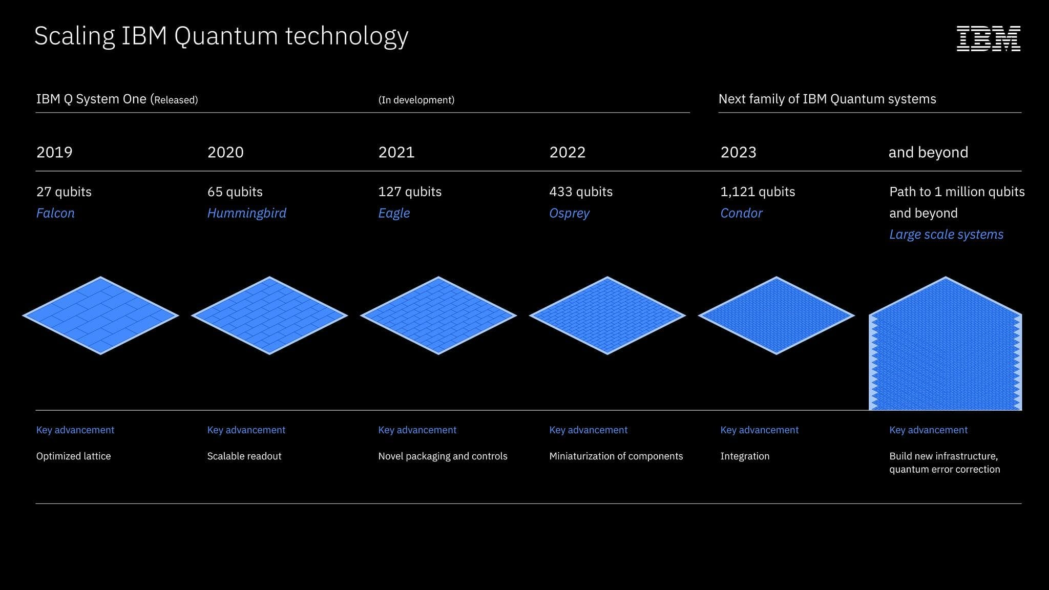
Today, you can run programs on 127 qubit quantum computers!

Slide 8


Qubits for Computational Supremacy
Google Quantum
Supremacy
Experiment
Supercomputer
(512TB)
Lab
Cluster
(256 GB)
Memory Capacity (GB)
University
Cluster (16TB)
Laptop
(8GB)
Number of Qubits

Slide 9
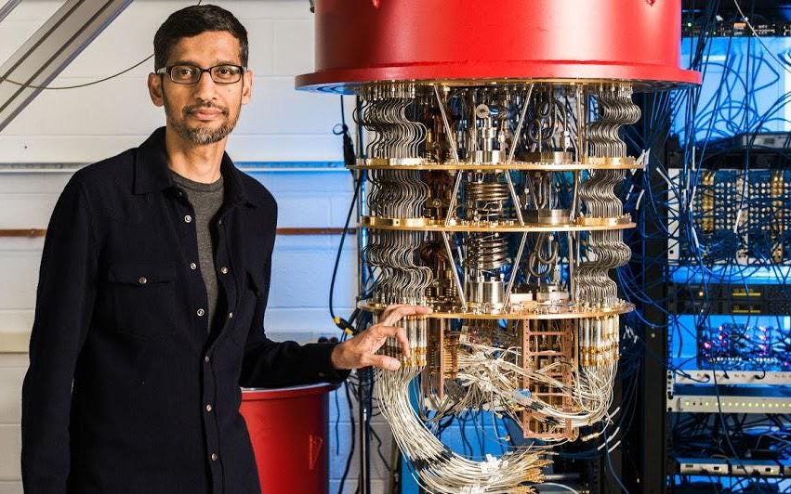
Google Declares Quantum Supremacy with 53 qubits
Supercomputer
10,000
years
Program
200
Seconds
Quantum Computer

Slide 10
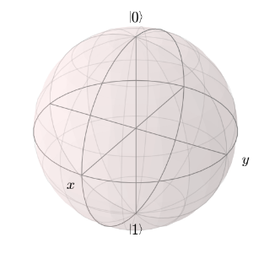
Qubit State Vulnerable to Errors
1
1
Decoherence: Quantum state decays with time and leaks information
Gate errors: Quantum operations or gates can introduce errors
Error
0
0
Time = 0
Time = t (100 µS)
1
Error
1
Quantum
gate
0
0
Hardware errors limit the capability of Quantum Computers

Slide 11
Quantum Error Correction is Expensive
Quantum Error Correction Code
Collection of Noisy
Physical Qubit Devices
Fault-Tolerant
Logical Qubit
Quantum Error Correction: Vulnerable Individually, tolerant to errors collectively
10 to 500 physical qubits to create one logical qubit

Slide 12


NISQ Model of Computing
Noisy Intermediate Scale Quantum Computers (NISQ)→ No Error Correction, learn to live with errors
Error free outcome
Quantum
Program
Quantum
Executable
Erroneous outcome
Compiler
Quantum Computer
1010
1000
QEXE
Output Probability
qft.qc
Output
Repeat Execution
for N Trials
1000
1110
1010
1011
0000
1100
Output Log of N trials
Use error mitigation and develop error tolerant algorithms

Slide 13
Quantum Computing is a Full Stack Problem
Problem
Problem
Algorithms
Q Algorithms
Tannu et al. [MICRO’17]
Tannu et al. [ASPLOS’19]
Tannu et al. [MICRO’19a]
Tannu et al. [MICRO’19b]
Das et al. [MICRO’19c]
Das et al. [MICRO’21a]
Tannu et al. [MICRO’21b]
Tannu et al. [ASPLOS’22]
PL, Compilers
Q-PL, Q-Compilers
Architecture
Q Architecture
Circuits
Q Interfaces
Devices
Q Devices
Photons/Ions/Electrons
Electrons
(Classical States)
(Quantum States)

Slide 14

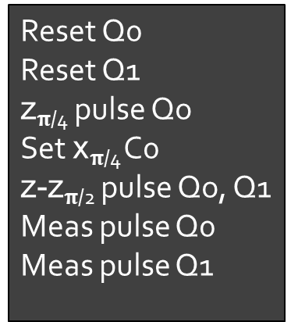
Compilers: Transform Program to Pulses
FPGA
High Level Program
Quantum
Compiler
Quantum_Funct (2);
S
Higher Quantum Assembly
Lower Assembly
Q₀
Q₁
creg c[2] ;
qreg q[2]; //qubit variable
H q[0]; //equal superposition
CNOT q[0], q[1]; //entangle
MEAS (q,c); //measure
Reset Q0
Reset Q1
z$π$_{/4} pulse Qo
Set x$π$_{/4} C0
z-z$π$_{/2} pulse Qo, Q1
Meas pulse Q0
Meas pulse Q1
Q₀
//
Q₁
//
1
1
S
//
//
Time

Slide 15
Outline
Qubit Errors
Noisy Neighbors
Too Many Wires

Slide 16
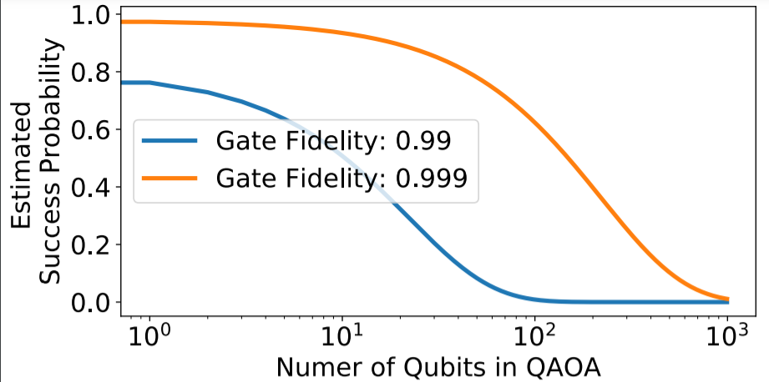
Challenge: Hardware (Qubit) Errors
Errors limit number of operations and scale of quantum program
Classical Heuristic
Needs Day
G₁
G₂
G₃
:
Variables in Optimization Problem
G_{N}

Slide 17
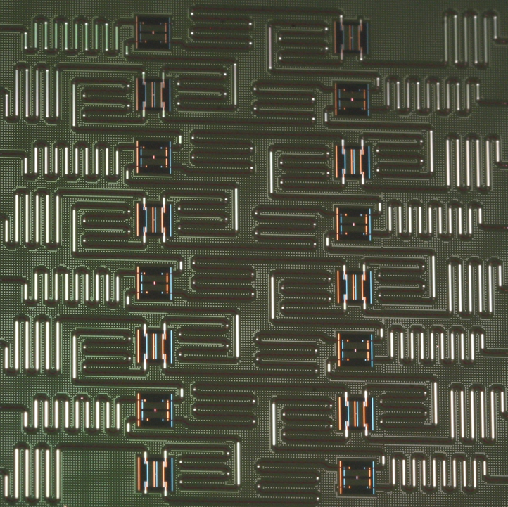


The Problem of Limited Connectivity
Schematic of Quantum Computer
Schematic of Quantum Computer
A
B
Qubit Device
C
Qubit Device
Not Possible no link between
A and B
CNOT A,B
Q1
Q2
Q3
SWAP B,C
link between
A and B, CNOT can be performed
Q6
Q5
Q4
CNOT A,B
SWAP facilitate data movement
SWAP facilitate data movement
SWAP → 3 CNOT Operations
Source: IBM
Compiler insert SWAPs → SWAPs are extra instructions which can also fail

Slide 18
Quantum Compilers for Error Mitigation
Reduce Operations
Increase Operational Parallelism
Better than Worst-case Errors
Pulse optimizations for faster and reliable gates
Quantum Supremacy, Quantum Volume demonstrations leverage compiler optimizations

Slide 19
Not All Qubits Are Created Equal
Variability: Some qubits and links fail with higher probability than others
Avoiding certain links can improve reliability significantly
Best SWAP
6% probability of Failure
Worst SWAP 40% Chance of Failure
Q1
Q2
Q1
Q2
Q3
Q3
Q6
Q6
Q6
Q5
Q4
Q4
Exploit variation in error rates to improve reliability
(assign more operations on reliable qubits/links)
Source: Tannu et al. [ASPLOS’19]

Slide 20
Correlated Errors
Quantum
Program
A
B
Trial 1
C
D
0.4
A
B
Trial 2
Probability
A
B
C
D
0.3
0.2
C
D
:
:
0.1
Quantum Computer
Best Mapping
00
01
10
11
Output
A
B
Trial N
C
D
Same
Mapping for
N Trials
Correlated
Errors
Incorrect output more
probable than correct

Slide 21


40%
20%
20%
20%
20%
20%
20%
20%
A
B
C
D
A
B
C
D
Which of the following is a patented color by an American professional sports team?
A. Fenway Green
A. Fenway Green
B. Magic Magenta
C. Burnt Orange
D. Georgian Blue

Slide 22
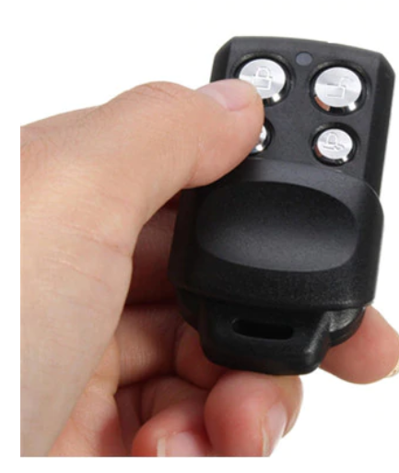



Lazy Audience → Correlated Mistakes
People who don’t know answer tend to select easiest option

Slide 23
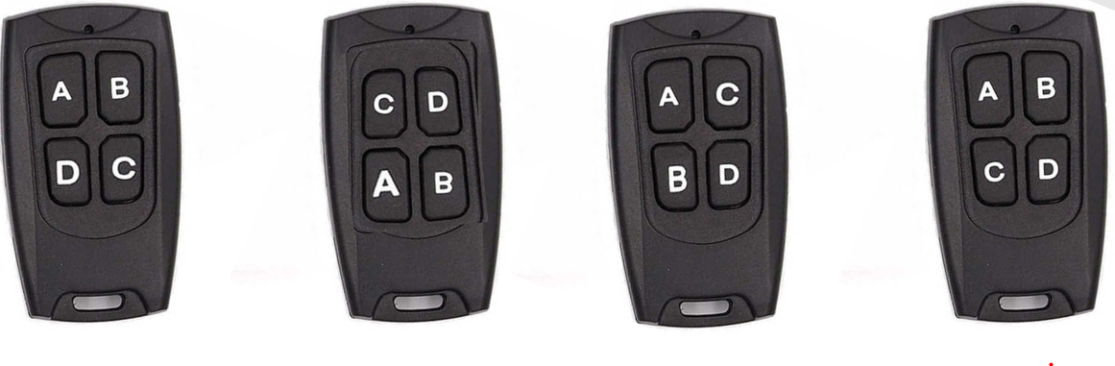
Use Ensemble to Break Correlation
Different versions, each with diverse option subjected to error

Slide 24
Can Diversity in Mapping Break Correlation?
Best Mapping
0.4
Probability
0.3
Run N/2 Trials
0.2
A
B
0.1
C
D
00
01
10
11
Output
Quantum
Program
Combine
Output
Probability
0.3
0.25
0.2
0.25
C
D
0.4
00
01
10
11
A
B
Probability
0.3
Output
Run N/2 Trials
0.2
0.1
2nd Best Mapping
00
01
10
11
Output
Source: Tannu et al. [MICRO’19]

Slide 25
Lower wait-times on Quantum Platforms
High Demand
Increasing
Gap
Pending Requests for access to IBM Q16 on different days
Expensive and Limited
Source: Das et al. [MICRO’19]

Slide 26
Concurrency: Enable Multi-Programming
Multi-programming can improve throughput, utilization, and cost
time = T1
P1
time = T1
P1
time = T2
P2
P2
Source: Das et al. [MICRO’19]
Current Approach
Proposed Approach

Slide 27
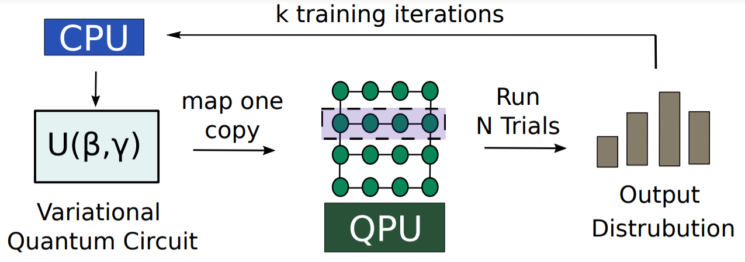
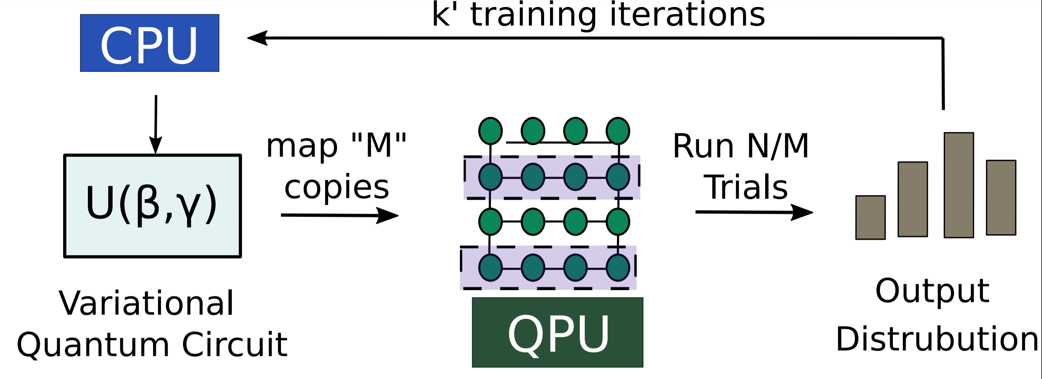
Concurrency: Faster Parameter Search
NISQ algorithms have training phase like ML algorithms
To train quantum circuits , we need ~10,000 shots and 10³ to 10⁷ iterations

Slide 28
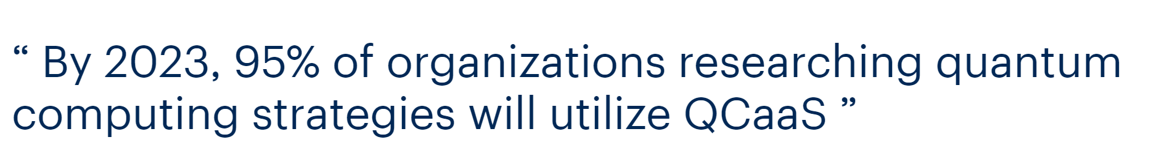
To Scale QCaaS → Concurrency is Essential
Systems Architecture for scaling Quantum Computing Services

Slide 29
Outline
Qubit Errors
Noisy Neighbors
Too Many Wires

Slide 30
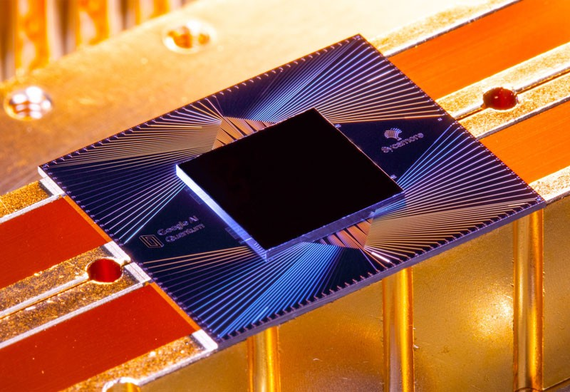
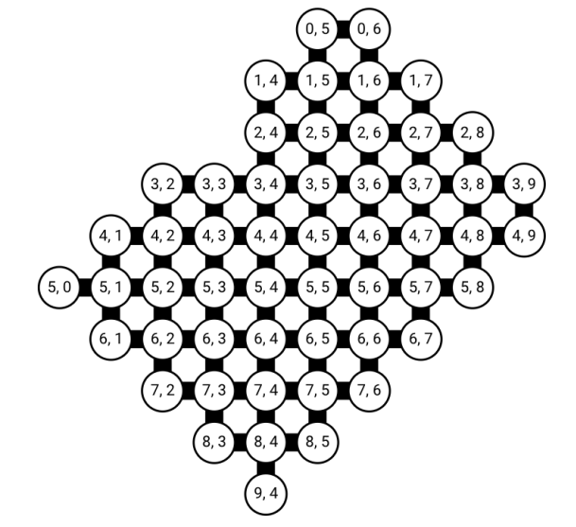
Google Sycamore: 53 Qubit Quantum Computer

Slide 31
Readout Crosstalk on Google Sycamore
Isolated
Concurrent
Readout Error Rate
Q0
U
Q0
U
Q1
Q1
Q2
Q2
Q3
Q3
Source: Sycamore datasheet
Crosstalk can significantly increase the readout errors

Slide 32
Readout Subsetting for Higher Fidelity
Input Circuit
Circuits with Partial Measurements (CPM)
. . .
Output Distribution
Marginal Distribution-1
Marginal Distribution-N
Reading subset of qubits can improve readout fidelity significantly

Slide 33
Evaluations
Average Fidelity Improvements: JigSaw: 2.1x, JigSaw-M: 2.5x

Slide 34




Not All Errors Are Equally Likely
4-qubit Bernstein Vazirani Program
Sorted by Hamming Distance (HD)
Uniform
More likely
HD=1
Incorrect
HD=3
HD=2
HD=4
Frequent incorrect outcomes are close to the correct one(s) in Hamming Space
Do errors have a structure?

Slide 35
HAMMER: Postprocessing
Output distribution
Probability
$$Likelihood Estimate: L\left(x\right)=P\left(x\right)∗S(x)$$
Output Strings
Hammer
Likelihood
Structure in Errors
1010
Output Strings
1110
1111
0111
1101
1011
0011
1001
Can we leverage the Hamming Structure to improve fidelity of NISQ programs?

Slide 36
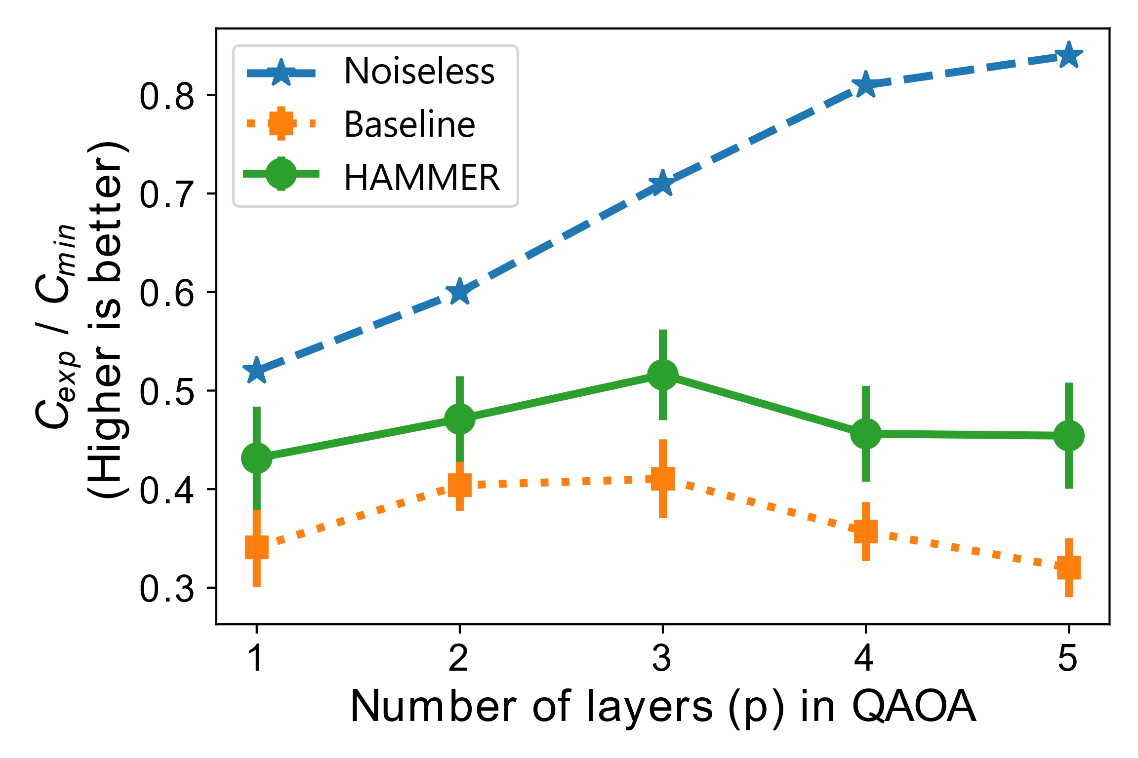
Evaluation of HAMMER with QAOA
Algorithmic quality of solution improves with number of layers used in the QAOA circuit
Increasing number layers demand more gates which results in higher noise, degrading quality of solution
HAMMER improves quality of solution by attenuating spurious outcomes

Slide 37
Outline
Qubit Errors
Noisy Neighbors
Too Many Wires

Slide 38
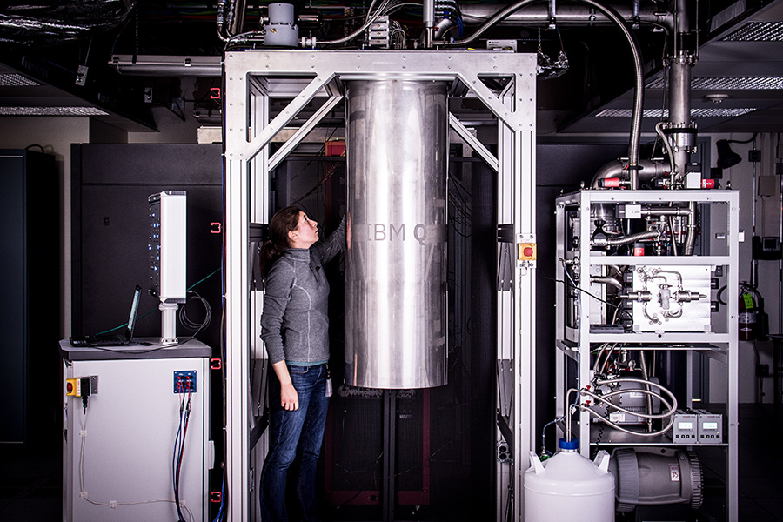
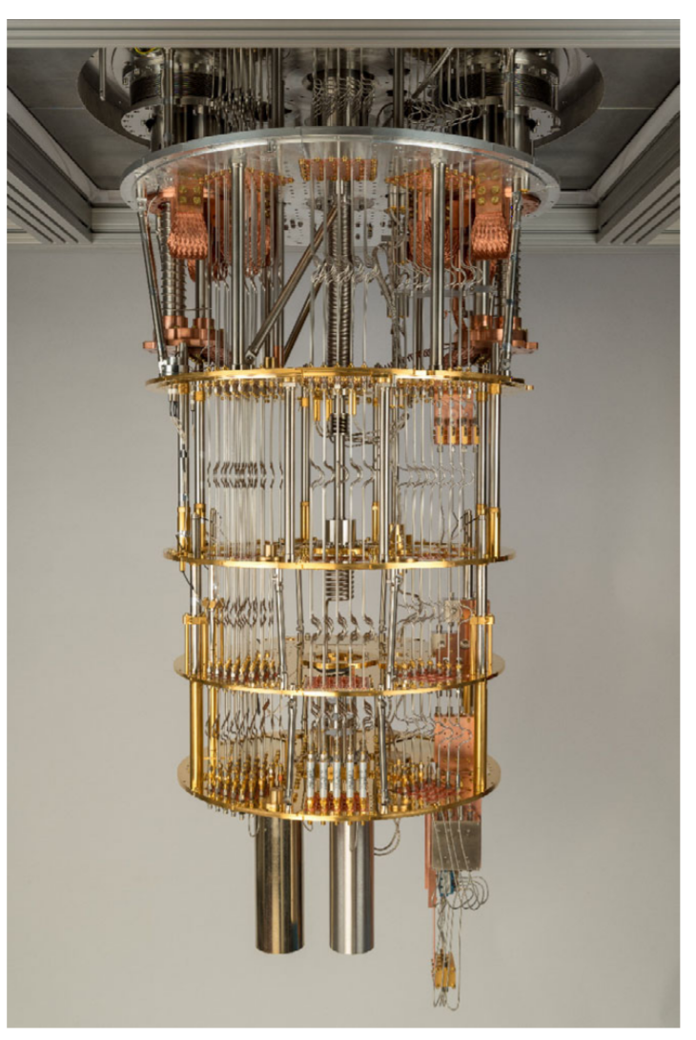
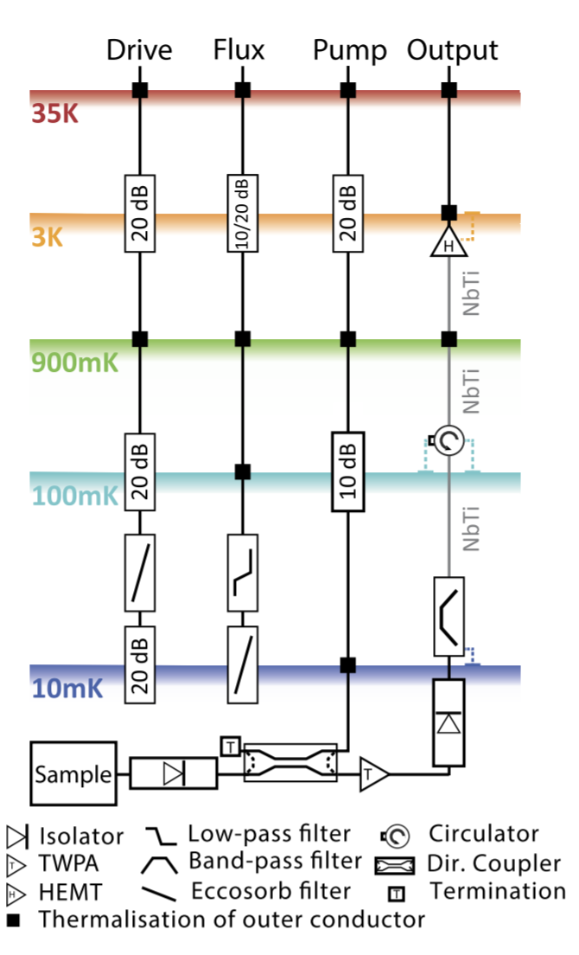
Quantum Bits Require Cryogenic Temperature
Dilution Refrigerator
Qubits
(20 mK)
- 459.3º F
Source: IBMQ, Engineering 100 Qubit Experiments Krinner et al. (ETH)

Slide 39
Cryogenic Control Processor
Control Processor
Control Processor
300K
4K
?
77K
Metal Wires
→ Thermal Leakage
Superconducting wires
→ Low Leakage
?
4K
0.1K
Qubits
20mK
20 mK
Qubits
20mK
(- 459.6 F)
Cryogenic Control Processor is essential for scalable Quantum Computer

Slide 40
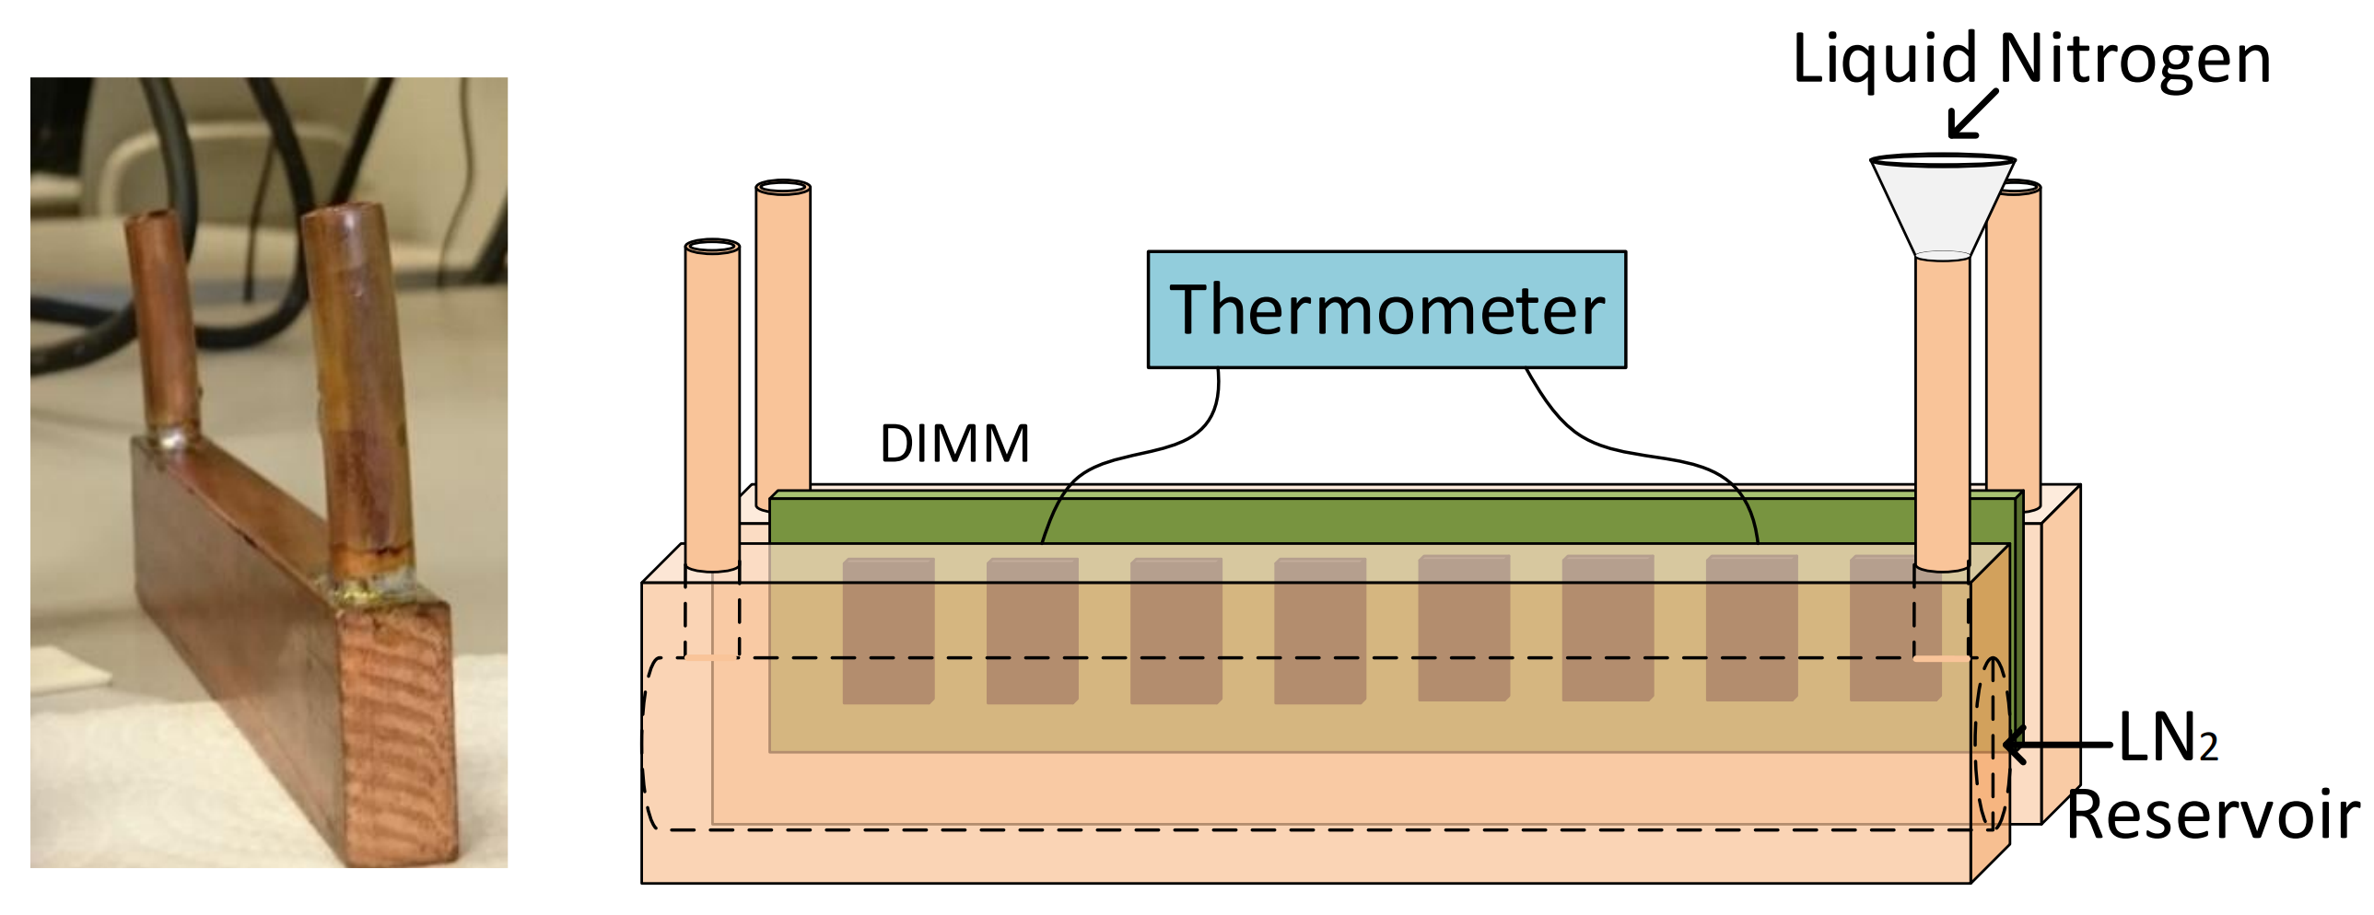
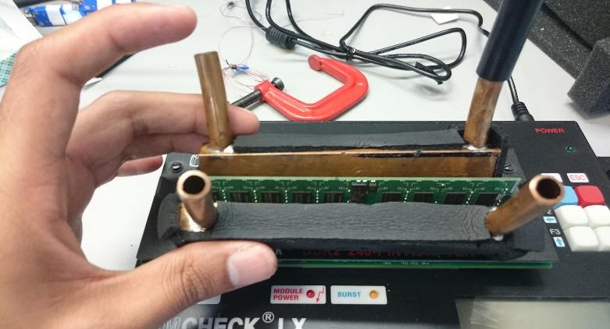
Scalable Control Computer Architecture
300K (Room Temperature)
Cryogenic
Memory
77K
Control
Computer
4K
0.1K
Cryogenic
Interconnects
20 mK
(- 459.6 F)

Slide 41

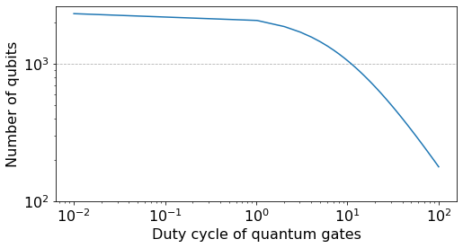
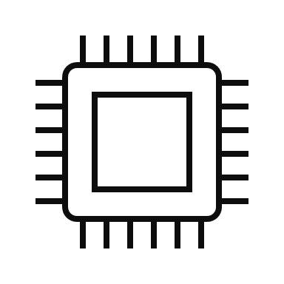
Concurrency and Scalability
Active power dissipated ∝ duty cycle (concurrency)
Number of qubits supported with coaxial cables
Quantum Error
Correction
Code
50K
4K
800mK
200mK
20mK
Dilution refrigerator
Higher duty cycles can limit max number of qubits we can support
Wires can limit scalability

Slide 42
A Case for Low Latency Digital Control
NISQ – Variational Algorithms
FTQC – Error Correction Cycle
Data Qubits
Ancilla
Qubits
Quantum Computer
Syndrome Generator
QEXE
Error
Repeat
1. Execute, estimate E[x]
2. Change parameters
3.Repeat until converged
Syndrome Measurement
Decoding/Inference is in the critical path→ need low latency control

Slide 43
Quantum Computing: Systems Roadmap
Software to Mitigate Hardware Errors
Scaling Software & Control Architecture
New Abstractions
Current NISQ
(100 Qubits)
Future NISQ
(500 Qubits)
More Qubits
(10,000 Qubits)

Slide 44

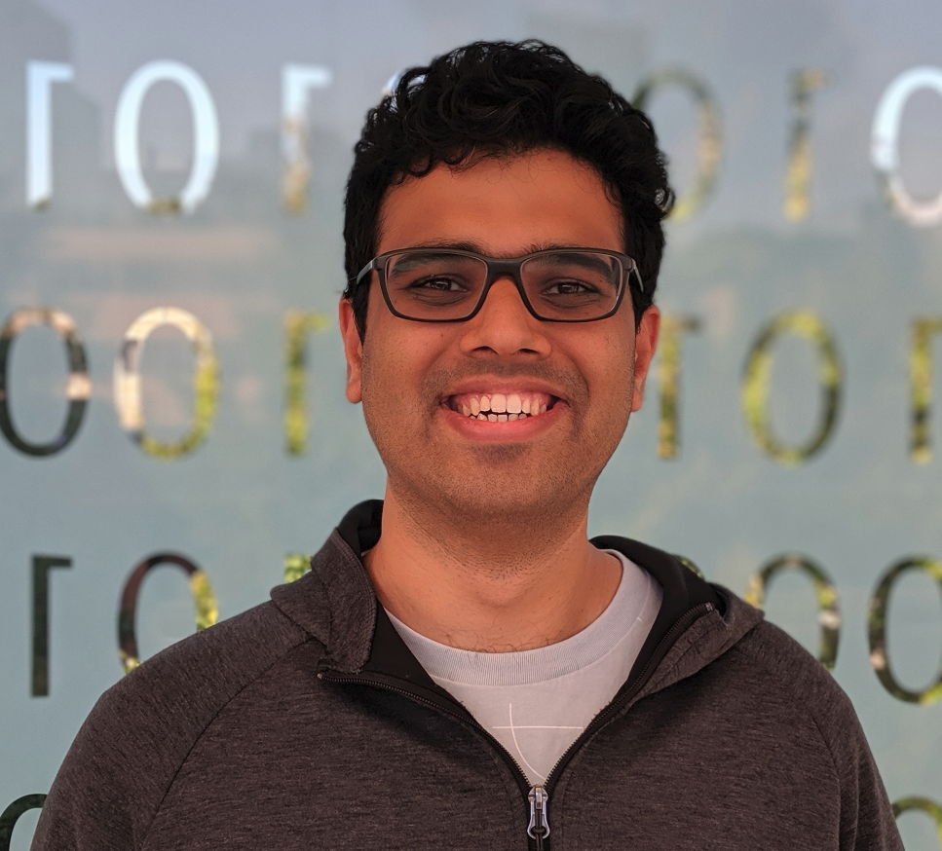
How to Build Thousand Qubit Quantum Computer and What to do with it?
Quantum Software and Architecture
Secure and Sustainable Computing
Swamit Tannu
swamit@cs.wisc.edu

